Slide 1


FlipFit

Slide 2

Team Members
Yasha Dayal (Team Leader)
Shraddha Chouksey
Abhijeet Gupta
Rolly Kumari
Aditi Dey
Palak Sharma
Jhanvi
Monika
Rinky Devi
Khushi Chauhan

Slide 3
Introduction
Stakeholders
Development
Agenda
Our Journey
User Stories
Tech Stack
Demo
Challenges

Slide 4
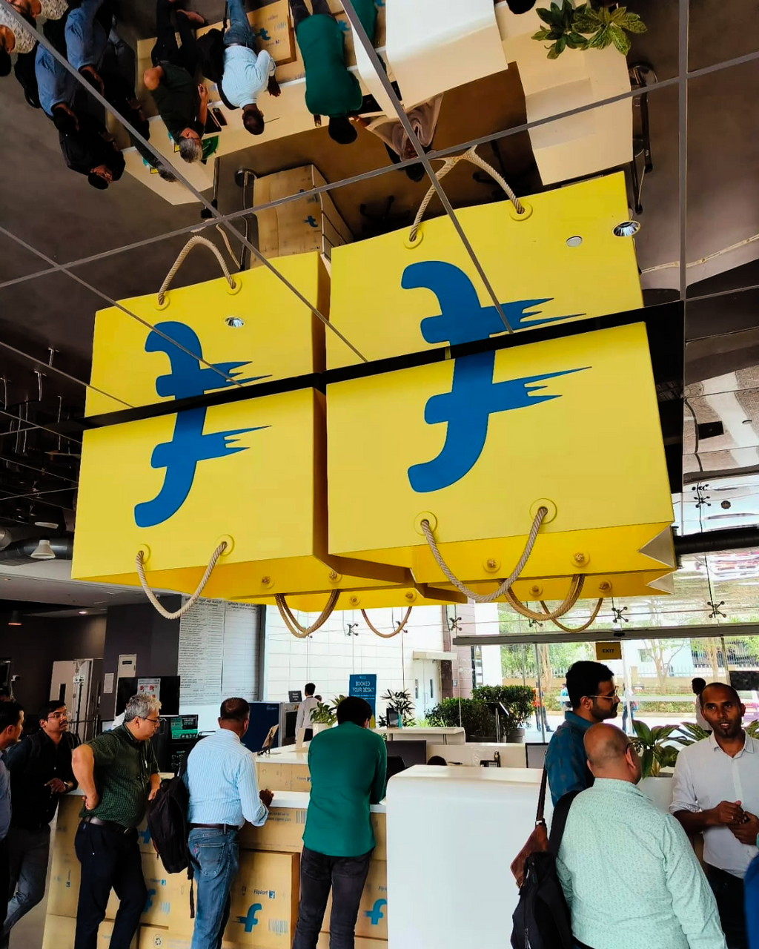
Introduction
The FlipFit app revolutionizes fitness access by allowing customers to seamlessly book gym slots across various centers, offering flexibility and convenience in their fitness routines.

Slide 5
Stakeholders
Admin
Gives the managerial approval required for registering gym center owners and manages bookings.
Gym Centre Owners
Provide facilities and services, and oversee the operational aspects of the gym.
Customers
Utilize gym facilities, seeking effective workouts and a positive experience.

Slide 6
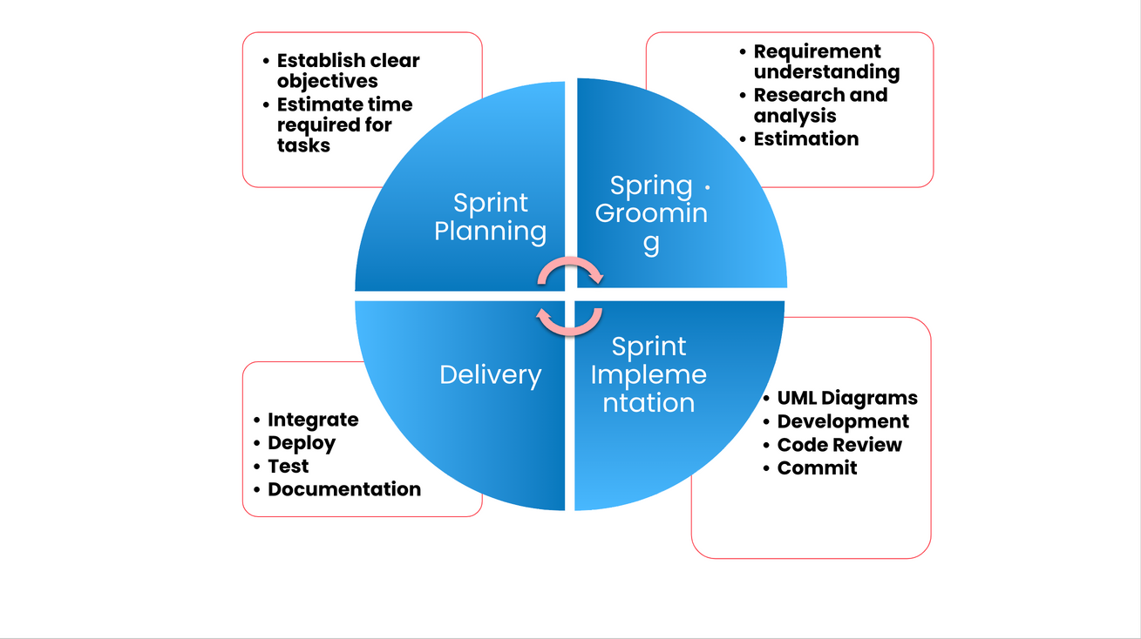
Development

Slide 7
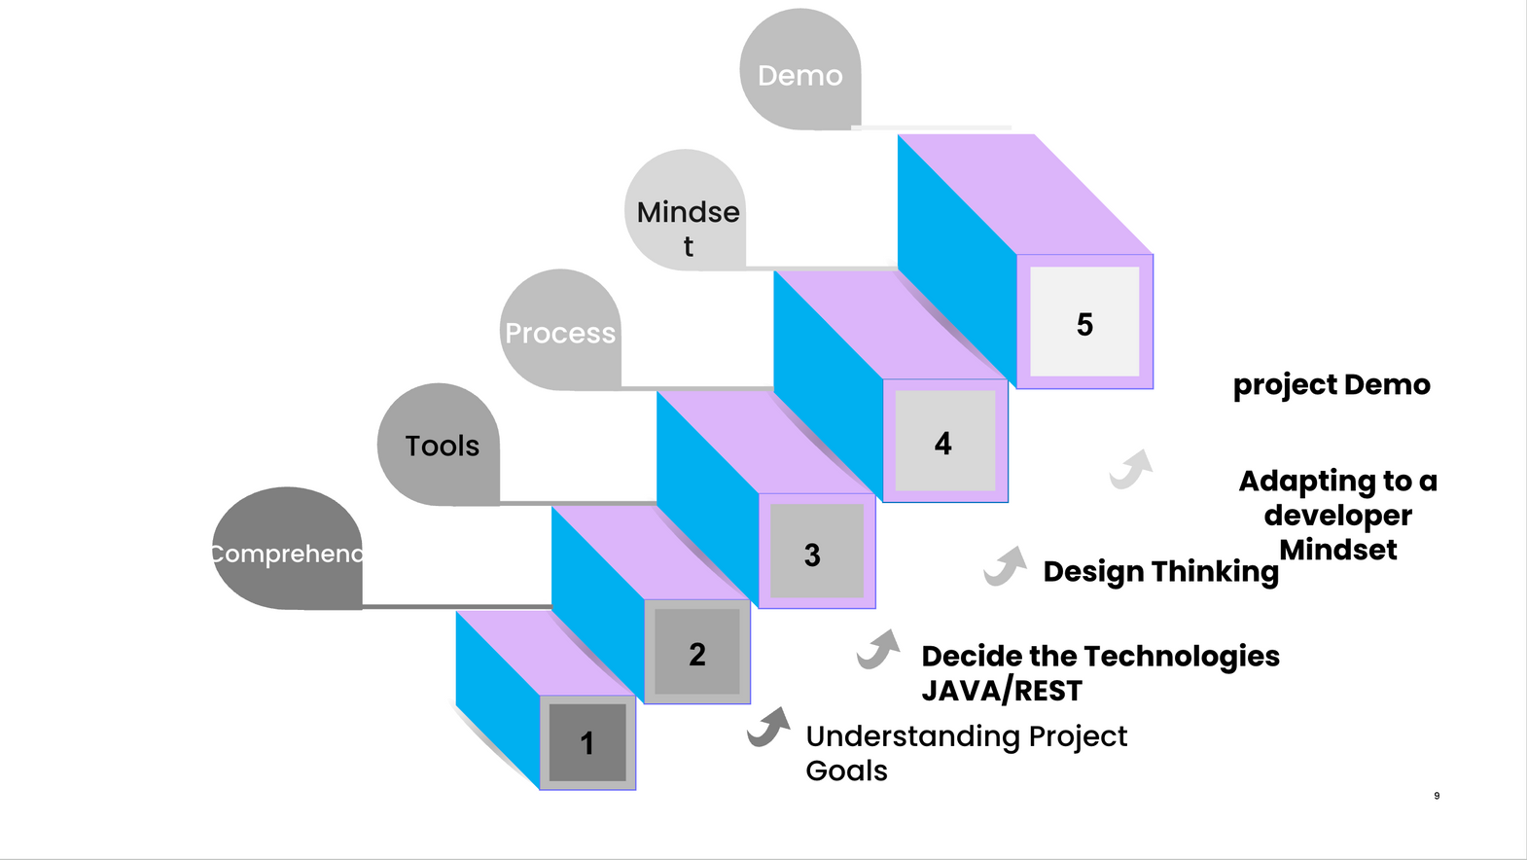
Our Journey

Slide 8
User Stories
FLIPFIT
CUSTOMER
GYM ADMIN
GYM OWNER
Customer Registration
Book Slots
View Booking
View Availability
View Slot Availability
Admin Registration
View centers
Manage Booking
Gym Owner Registration
Add Slots
Add Centers
Manage Booking

Slide 9






Tech Stack 'n' Tools
Bryan Cook
Chief Finance Officer
Bryan Cook
Chief Finance Officer
Bryan Cook
Chief Finance Officer
Bryan Cook
Chief Finance Officer
Git
Github
Java
Mysql

Slide 10
Demo

Slide 11

CHALLENGES
New Tech Stack
Most of us were new to Java, Git and various APIs, so this proved to be challenging but a great learning oppurtunity.
Merge Conficts
Ten of us were continuously working on the git repo so there were too many merge conflicts.
Database Connections
The database schema had to be changed multiple times to make it sync with the code.

Slide 12
Thank You!

